Slide 1
Pipe Jacking v Open-Cut CO₂ Calculator
Developing a CO₂ Calculator
The Pipe Jacking Association has developed a free and easy to use web-based tool to compare greenhouse gas emissions for pipe jacking and microtunnelling with open-cut for sewer and utility pipeline installation

Slide 2
Why develop a carbon calculator for utility installation?
The UK Government through the Department of Energy and Climate Change (DECC) is committed to reducing carbon emissions by 80% on 1990 levels by 2050. This ambition is enshrined in UK law with binding targets spanning successive Parliaments
Utilities have an obligation to cut emissions and improve energy efficiency under the DECC CRC Energy Efficiency Scheme
DEFRA’s Key Performance Indicators (KPIs) oblige utilities to demonstrate corporate sustainability
Carbon emissions apart, it is accepted that digging up roads for utility installation when there are practical and economic alternatives is socially unacceptable

Slide 3
Background
A carbon calculator developed to highlight the reduction potential of trenchless technology had been developed by the British Colombia Chapter of the North American Society of Trenchless Technology in association with the Action on Climate Change Team (ACT) of Simon Fraser University in British Columbia
The project was transferred to NYSEARCH, a New York based research group, that works on behalf of North American gas and water utilities and the project put on hold
As a result the UK Pipe Jacking Association decided to sponsor the development of a free and easy to use calculator and appointed TRL to carry out the project

Slide 4
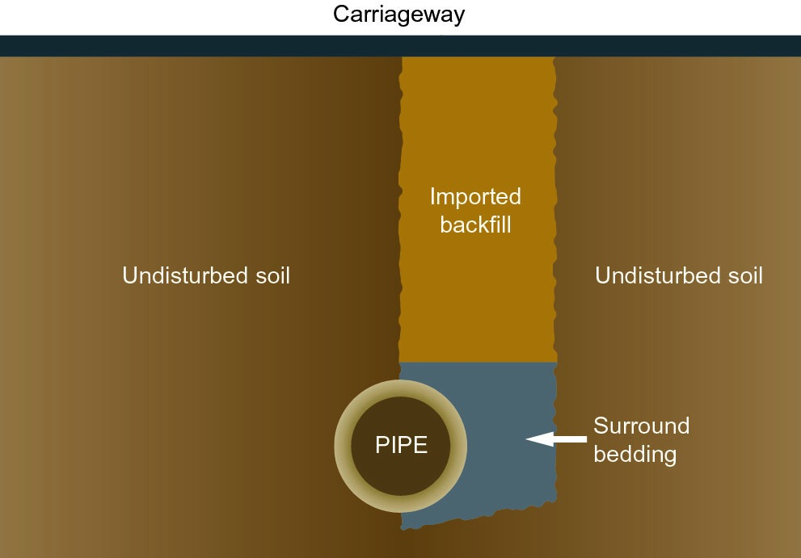
Trenchless
Open-Cut

Slide 5
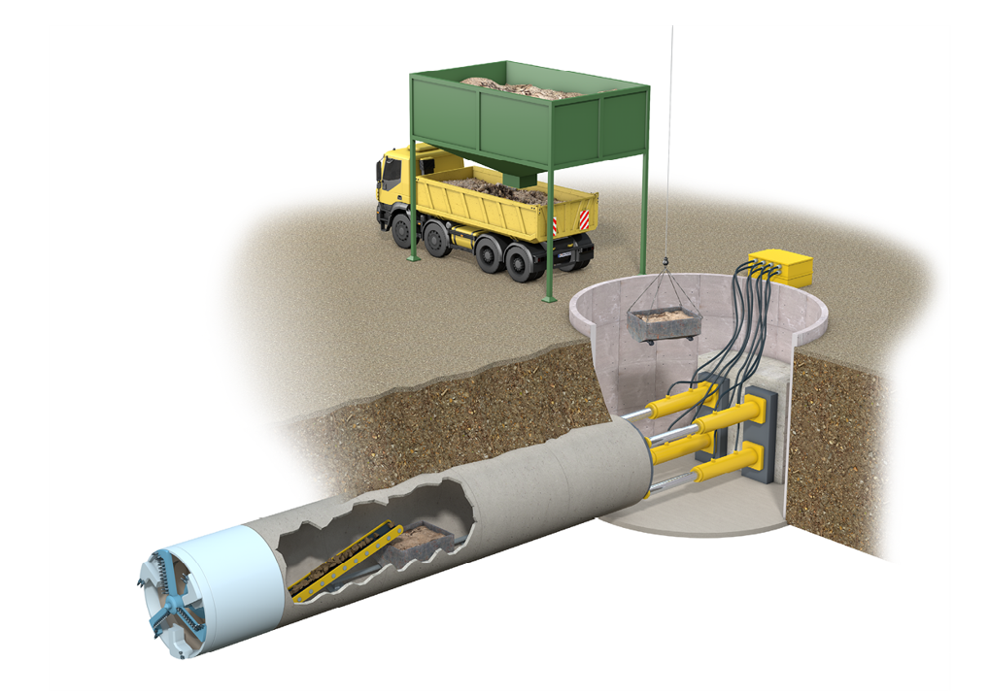
Pipe Jacking is an integrated system linking:
soils
jacking shaft
pipes
shields
jacking loads
engineering
Notes:
The integrity of a pipe jacking operation is dependent on the inter-relationship of a number of factors which can be summarised as follows:
- soil investigation and interpretation
- jacking shaft design
- pipe design
- pipejack shield selection
- hydraulic considerations
- laser engineering and control

Slide 6
Objective
To develop a calculator to compare carbon emissions for pipe jacking and microtunnelling with open-cut construction for sewer and utility pipeline installation that was:
Easy to use
Transparent
Comprehensive – to include all parameters
Authoritative
Verified

Slide 7
Input Datasets
The PJA prepared a range of datasets covering all pipe jacking and microtunelling and open-cut operations:
Comprehensive materials schedule for all pipe diameters from 200 – 2400mm to include manholes, shafts, base slabs and all other components that impact on carbon emissions
Plant schedules for both scenarios together with energy usage
Machinery selection for all diameters in differing ground conditions, both wet and dry
Project duration – realistic outputs and daily hours worked
Average haulage distances for plant and materials

Slide 8
Consultant Appointed
The PJA appointed TRL to carry out the project. TRL is an internationally recognised centre of excellence providing world-class research, consultancy, testing and certification for all aspects of transport
The Association had worked with TRL previously in the production of a report “Mitigating the disruption caused by utility roadworks” which it is believed had a significant influence in revisions to the New Roads and Streetworks Act and the introduction of Lane Rental

Slide 9
TRL Data Sources and Protocols
University of Bath Inventory of Carbon and Energy for construction materials
Concrete Pipeline Systems Association – Carbon Footprint of pipes, slabs and manholes
TRL’s QUADRO program (Queues and Delays at Roadworks)
PAS 2050: Assessing the Life Cycle Greenhouse Gas Emissions of Goods and Services

Slide 10
A life cycle approach
Advocated by PAS 2050
Assesses part of a pipeline’s life cycle
Raw material extraction to installation
Designed to be a comparative tool
open cut vs. pipe jacking on a level playing-field
Consequential impacts not included
Re-instatement following open cut installation can result in significant highway degradation though not assessed at this stage

Slide 11
Materials
Transport
Installation
Traffic
Product carbon footprints:
Manufactured pipeline components: pipes, manholes, bases & covers
Virgin aggregate fill
Asphalt
Transport emissions:
Pipeline components to site
Fill and asphalt to site
Spoil to disposal
Trench support to and from site
Machinery fuel consumption:
Detailed equipment inventories
Duration of operation algorithms
Load factors based on soil type
Presence of groundwater
Emissions from queuing traffic:
Lane closures - shuttle working for open cut
Dependent on road types and traffic levels
QUADRO

Slide 12
FEASIBILITY
AS DESIGNED
AS BUILT
Enter the pipeline depth, length and diameter
All other parameters auto-filled
Gives a “ballpark” CO₂e estimate
More parameters are certain
Enter additional info regarding the site location, type of machinery, outputs and working durations
Makes the “best available prediction”
Enter retrospective information on all parameters
Effectively “audits” the as designed CO₂e figures
PREDICTION EVALUATION
INCREASING LEVEL OF DATA INPUT
INCREASING ACCURACY

Slide 13
Data Verification
An independent external source was used to verify the methodology and outputs produced by TRL
Verification was carried out by WRc, a research-based consultancy, that utilises scientific and engineering skills to develop robust and sustainable solutions for clients in the water and waste industry. The Calculator has been verified by WRc

Slide 14
WRc Peer Review
WRc’s audit examined the numerous equations developed by TRL to compare outputs between pipejacking and conventional open-cut trenching
These calculations traced the input/output of CO₂ for materials, transport, traffic and machinery and equipment
WRc also reviewed the data sources and assumptions used in the calculator although it did not review the sources for emission factors used by TRL as these are generally accepted industry standards

Slide 15
Home Page

Slide 16
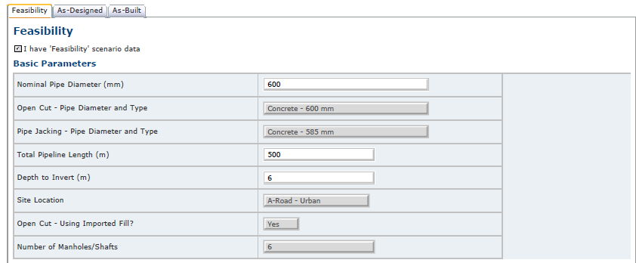
User Input Screen: Basic parameters
At feasibility stage the only inputs required are diameter, length and depth

Slide 17
User Input Screen: Site parameters, machinery, transport and traffic
At feasibility these are default values detailed in data sources and assumptions

Slide 18
Report Output
Following data input, reports are produced literally in seconds and can either be saved or printed. Reports include:
Basic parameters – diameter, length, depth, manholes/shafts and road type
Site parameters – groundwater, construction period and working hours
Machinery selection
Transport and traffic management options
Tonnes of CO₂e generated for each of the above and also for traffic delays at the site for open cut scenario
Data Sources and Assumptions

Slide 19
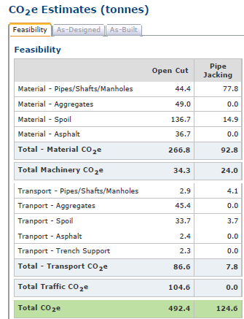
Report Output Screen

Slide 20
Examples of CO₂ Savings using pipejacking
600mm dia x 500m length x 6m deep – 75% saving (Open cut 492.4 tonnes: Pipejacking 124.6 tonnes)
1200mm dia x 500m length x 6m deep – 57% saving (Open cut 756.5 tonnes: Pipejacking 328.3 tonnes)
600mm dia x 500m length x 4m deep – 67% saving (Open cut 351.4 tonnes: Pipejacking 113.3 tonnes)
1200mm dia x 500m length x 4m deep – 47% saving (Open cut 570.6 tonnes: Pipejacking 301.8 tonnes)

Slide 21
Overview
Carbon savings only represents one of the benefits offered through the use of trenchless technology with emission savings of up to 75%
Pavement life is reduced by up to 30% by open cut construction
Lane rental costs for open-cut of up to £2,500 per day are a real cost to the community
Roadworks related congestion costs the economy £4bn a year (DfT press release Jan 2012)

Slide 22
Your guarantee of quality and experience
^{www.pipejacking.org}

